Slide 1
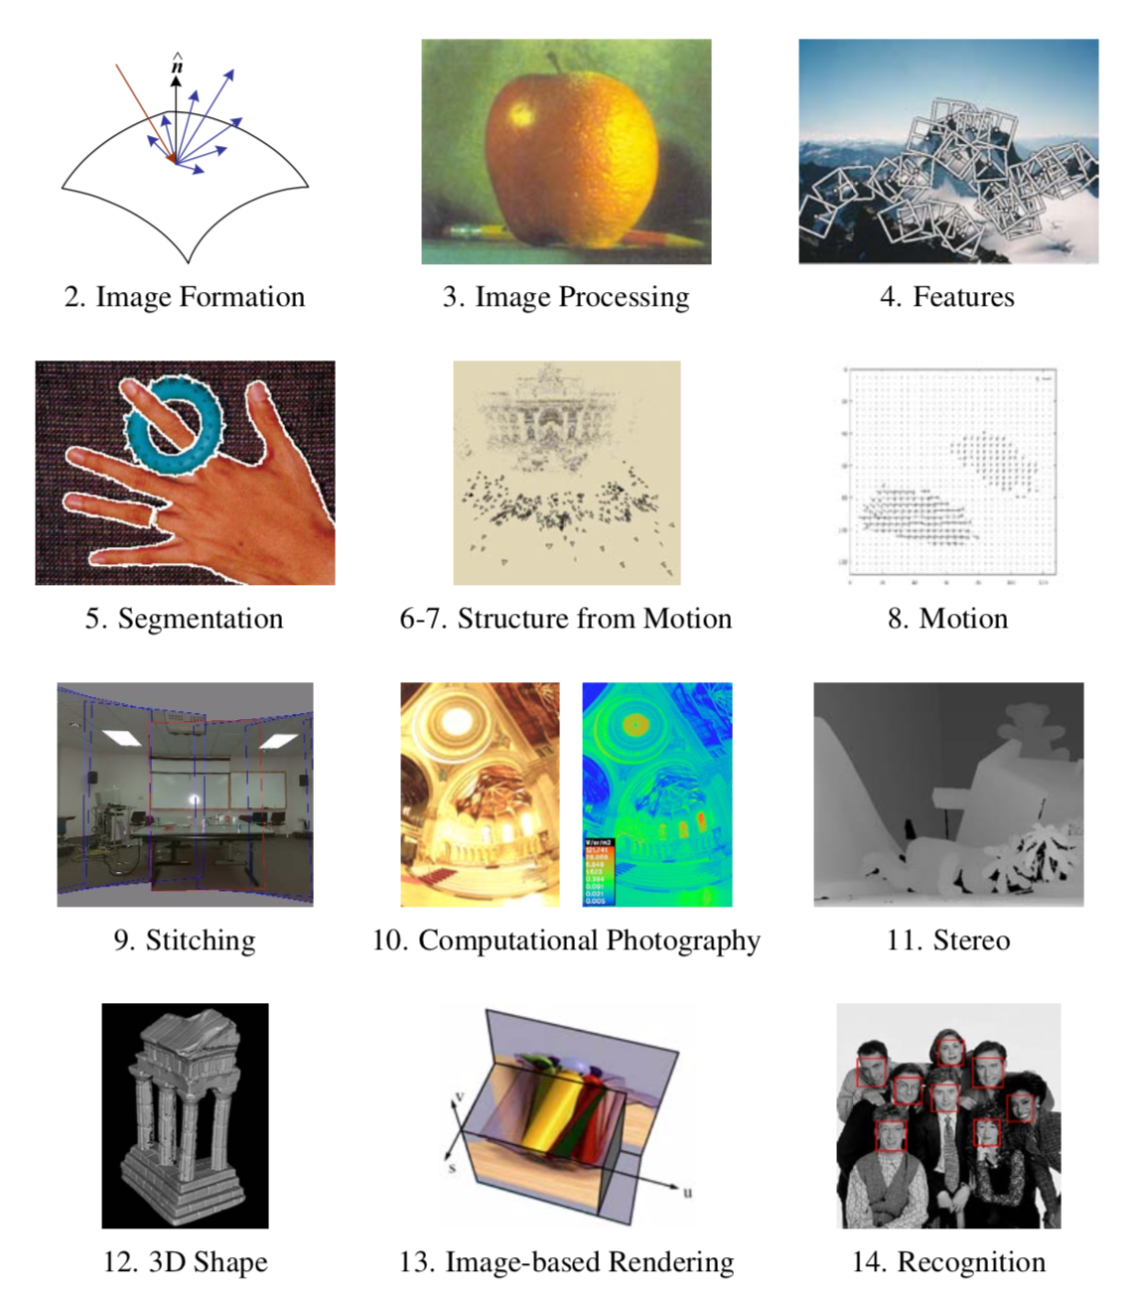

Slide 2
Credits
Images and formulas from Szeliski
Second half from CVPR talk by Zhaoyang Lv
Taking a Deeper Look at the Inverse Compositional Algorithm, Zhaoyang Lv , Frank Dellaert, James M. Rehg, Andreas Geiger, CVPR 2019

Slide 3
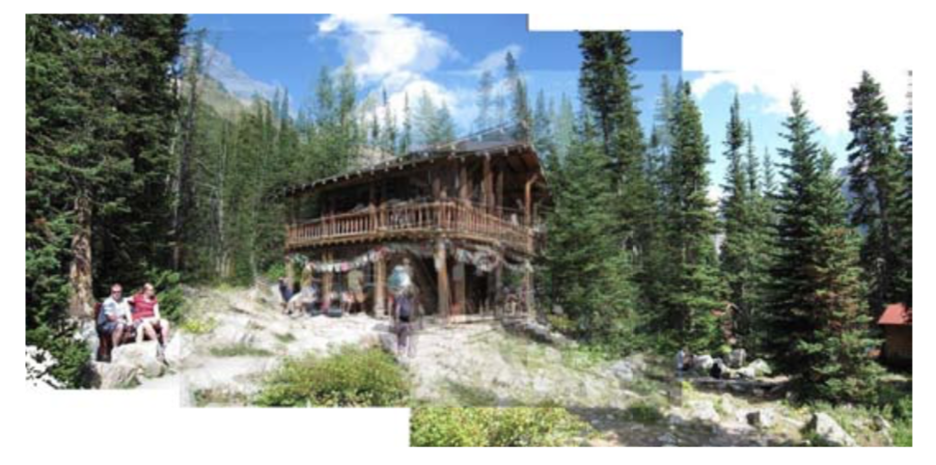
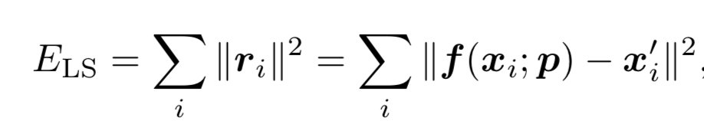
Translational Alignment
Shift image I₁ with respect to template I₀
Before, feature-based error:

Slide 4
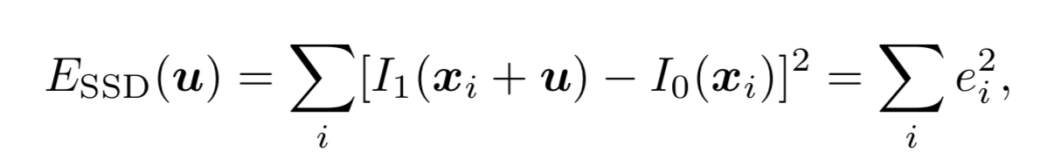
Translational Alignment
Shift image I₁ with respect to template I₀
Before, feature-based error:
Now, image-based error:

Slide 5
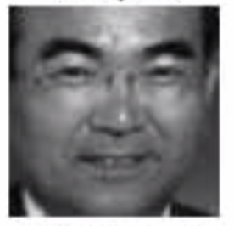
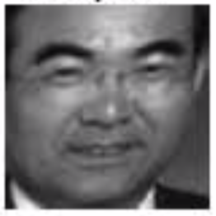
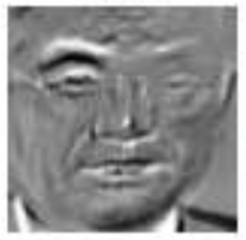
SSD
Sum of Squared Differences
Assumes: brightness constancy
If u fractional: interpolation needed
Bilinear (fast, good)
Bicubic (slower, slightly better)

Slide 6
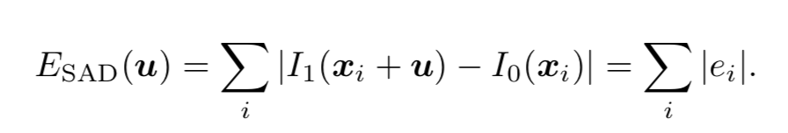
Robust Error Metrics
Quadratic error is unforgiving!
Absolute error (SAD): allows for outliers
Differentiable robust error metrics exist

Slide 7
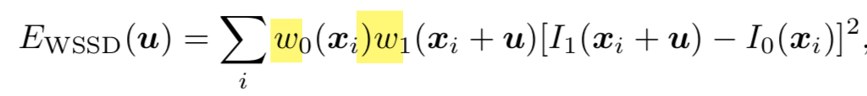
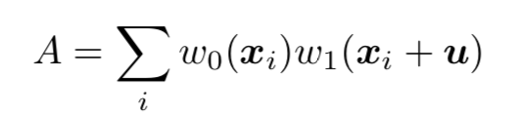
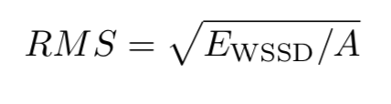
Dealing with Boundary Conditions
Should not count pixels outside
Add two “window” functions
Windowed SSD metric:
Invariant to overlap: Root mean square:

Slide 8
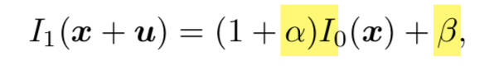
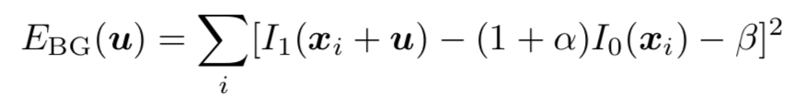
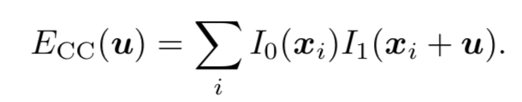
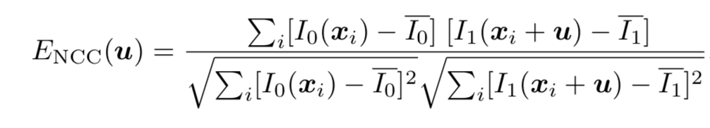
Violations of Brightness Constancy
Estimate Bias and Gain
Normalized Cross-Correlation

Slide 9
Hierarchical Motion Estimation
Build an image pyramid:
Low-pass
Decimate
Recursively estimate motion:
Estimate motion at highest level
Use result as initial estimate at lower level

Slide 10
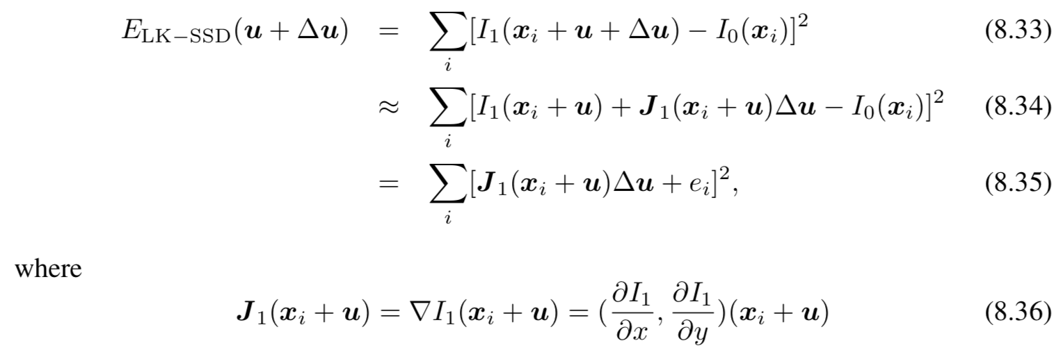
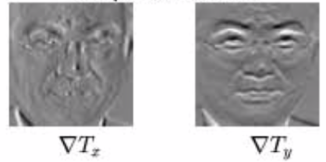
Sub-pixel Refinement
Taylor expansion:

Slide 11
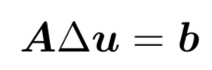
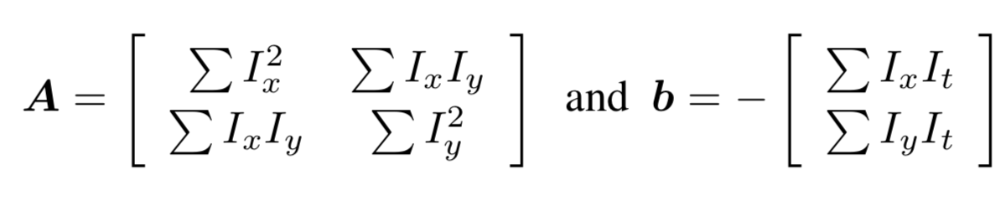
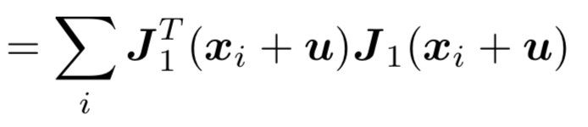
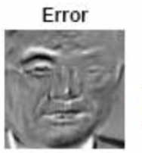
Solve using Normal Equations
RHS b is just dot product of gradient images with error ->
A is Hessian or ”information matrix”, same as Harris uses!
Remember: feature-based translation: just mean of flow vectors !

Slide 12
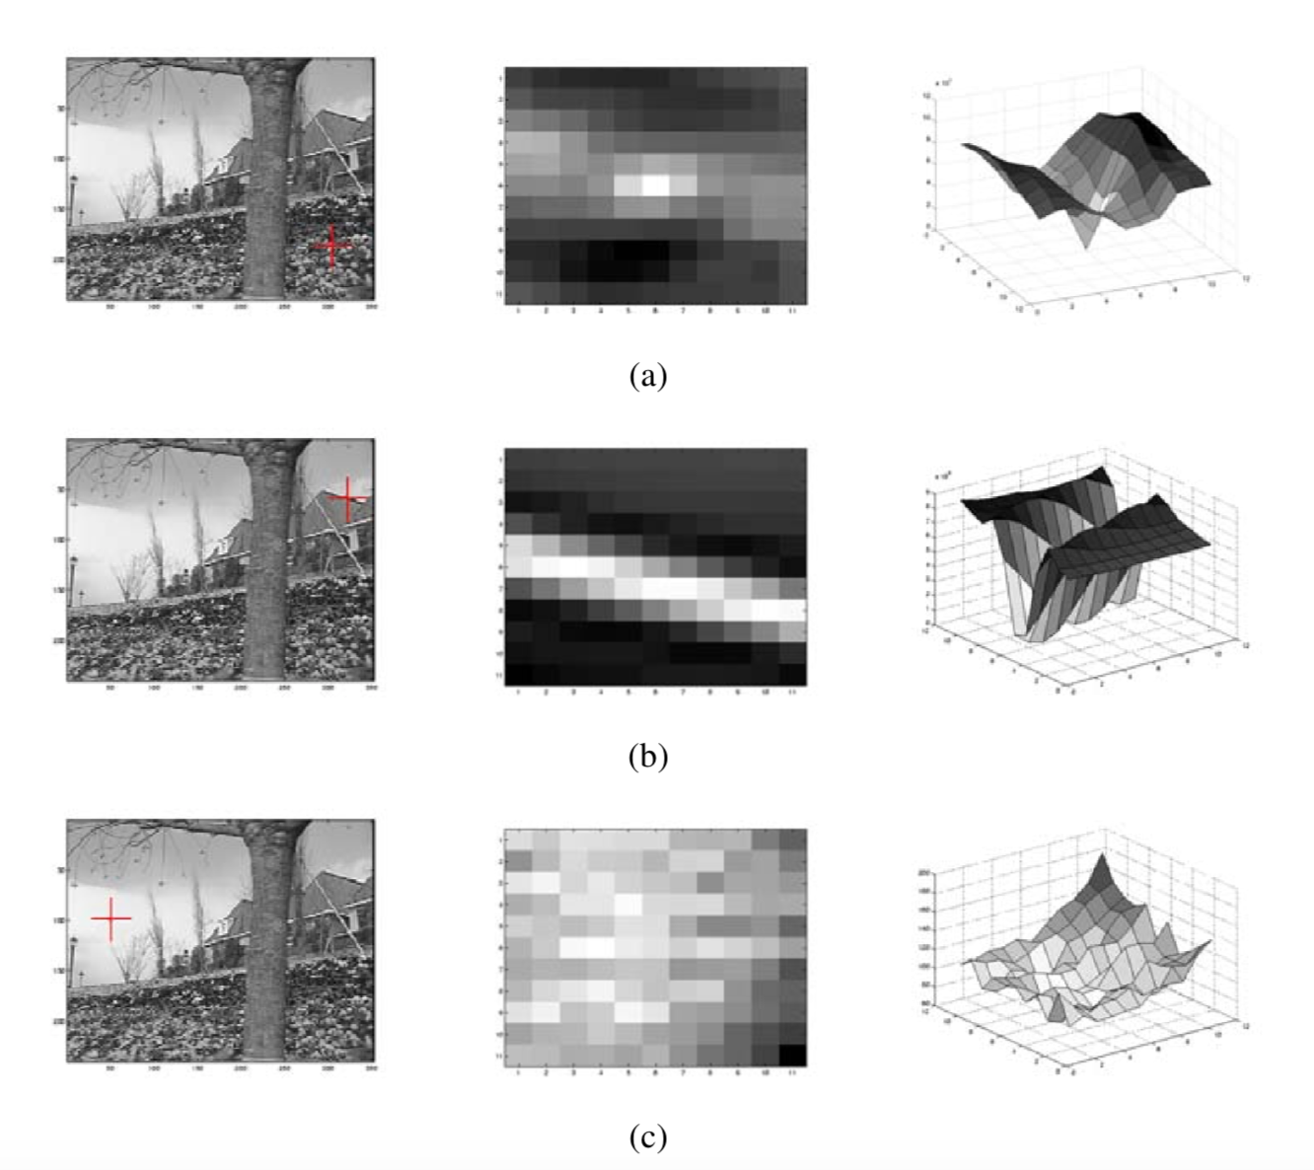
Aperture Problems and Harris

Slide 13
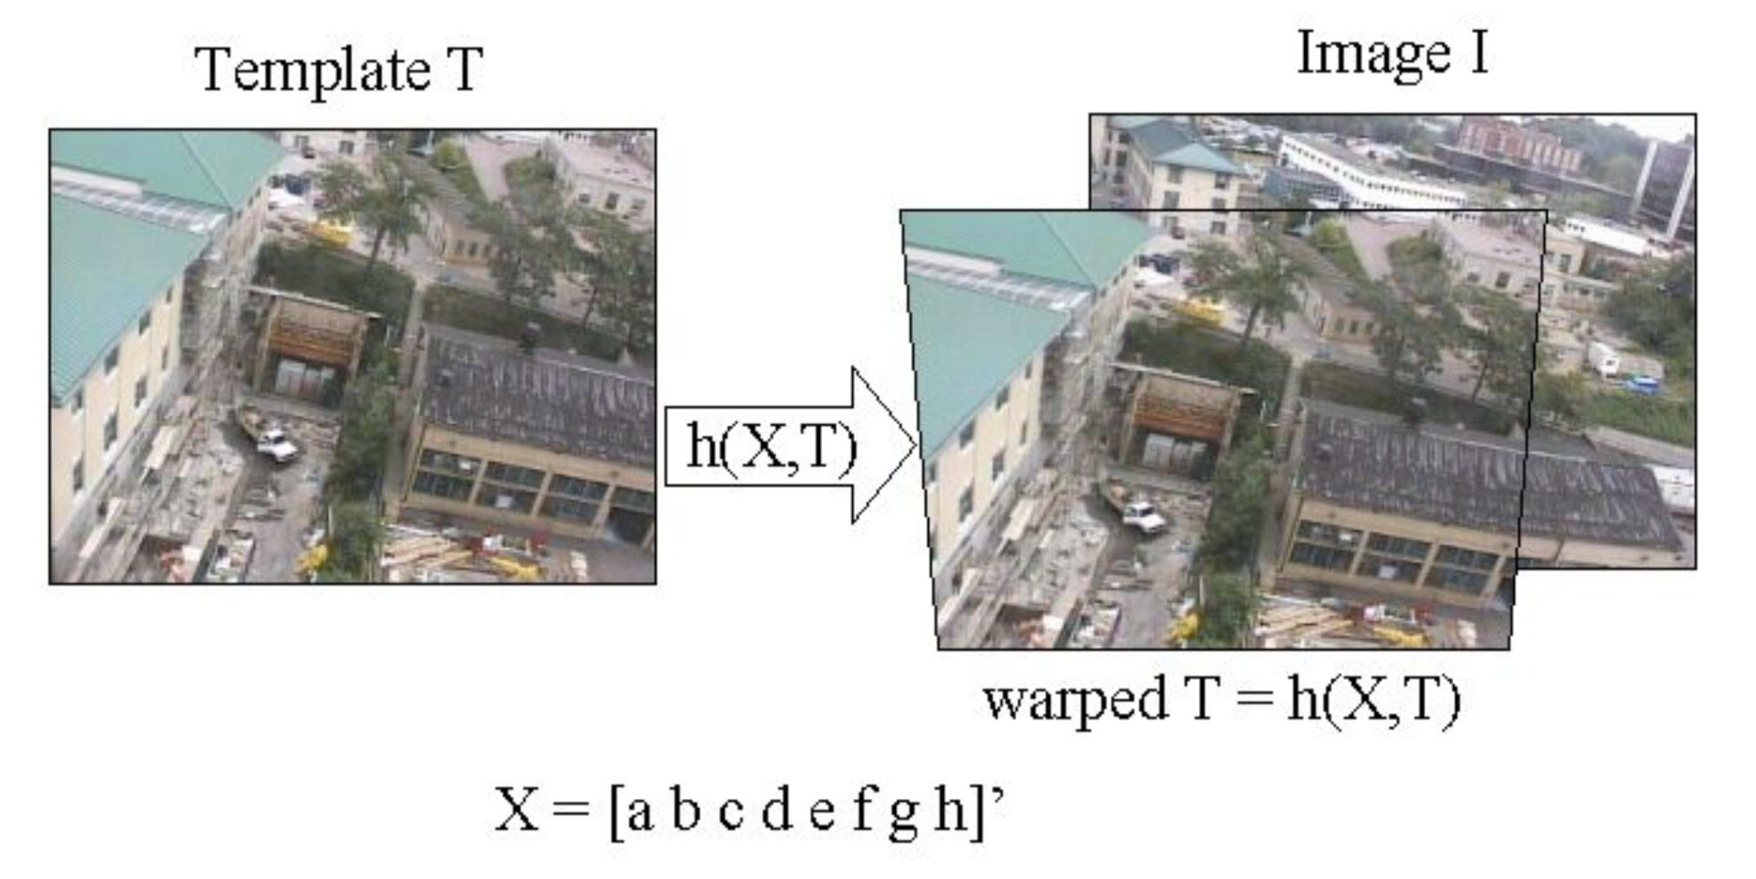
Parametric Motion
E.g., image-based homography estimation
Dellaert & Collins, 1999, Fast Image-Based Tracking by Selective Pixel Integration

Slide 14
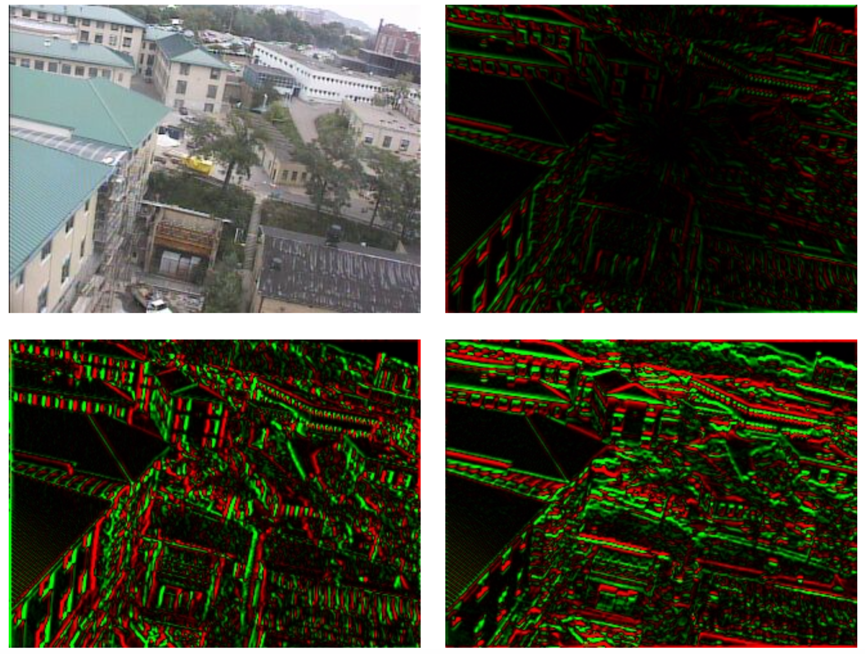
”Jacobian Images”
Dellaert & Collins, 1999, Fast Image-Based Tracking by Selective Pixel Integration

Slide 15
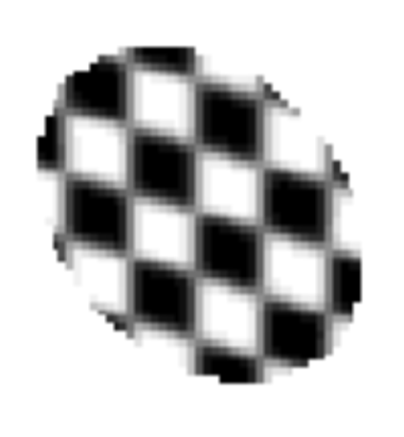
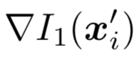

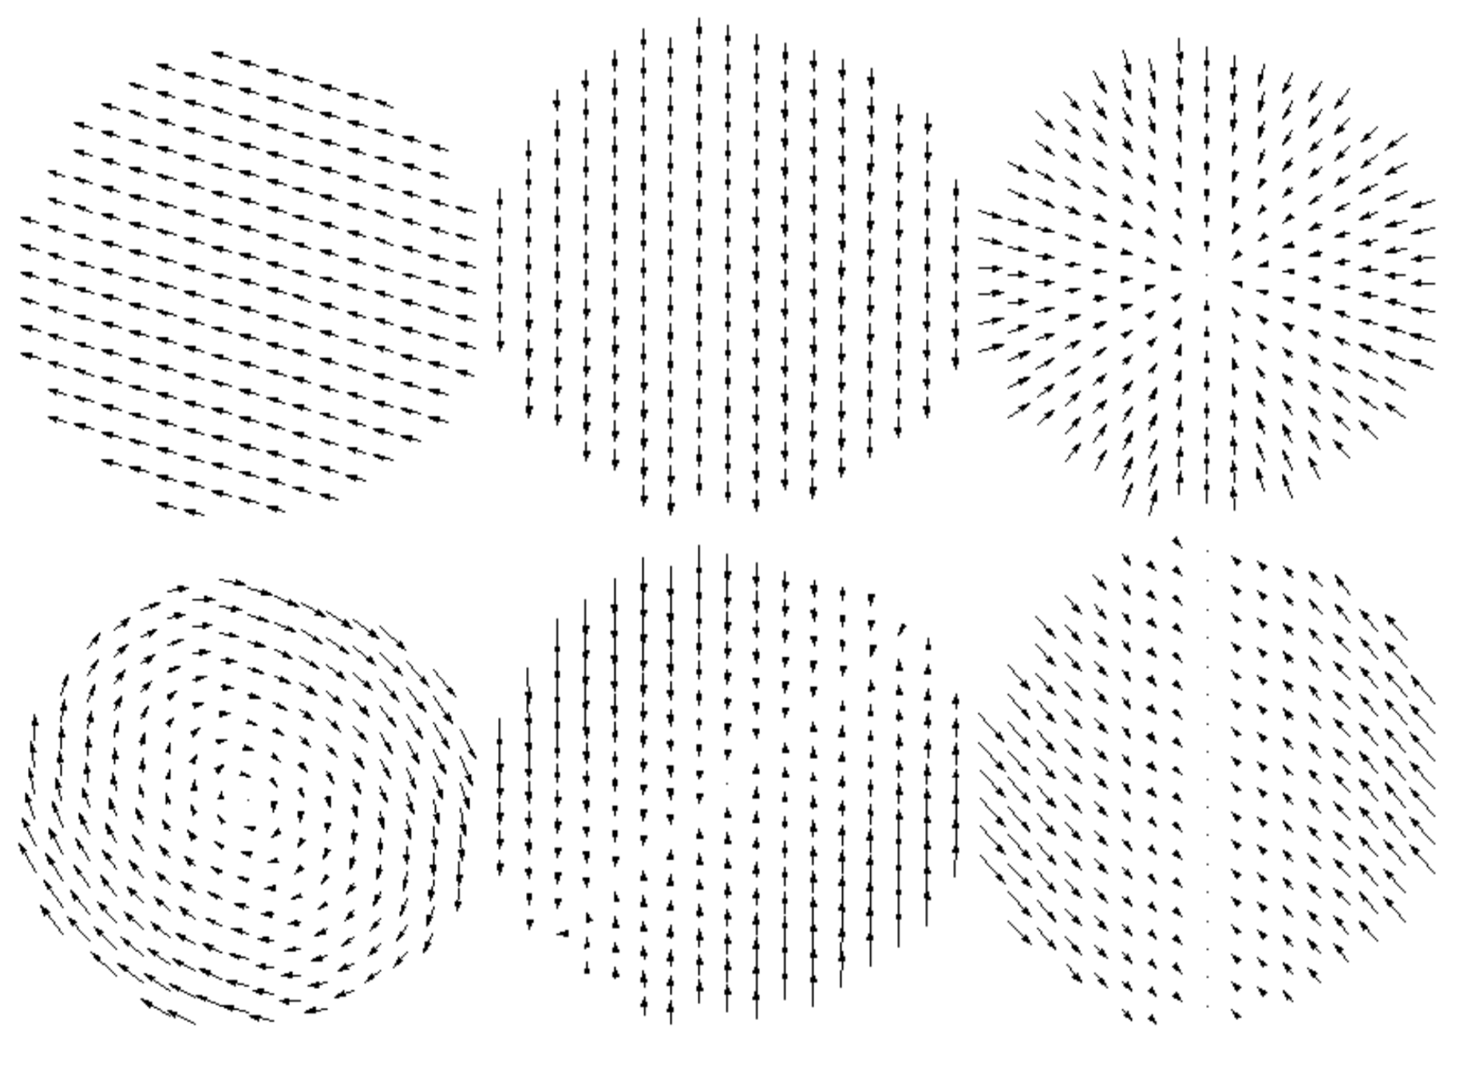
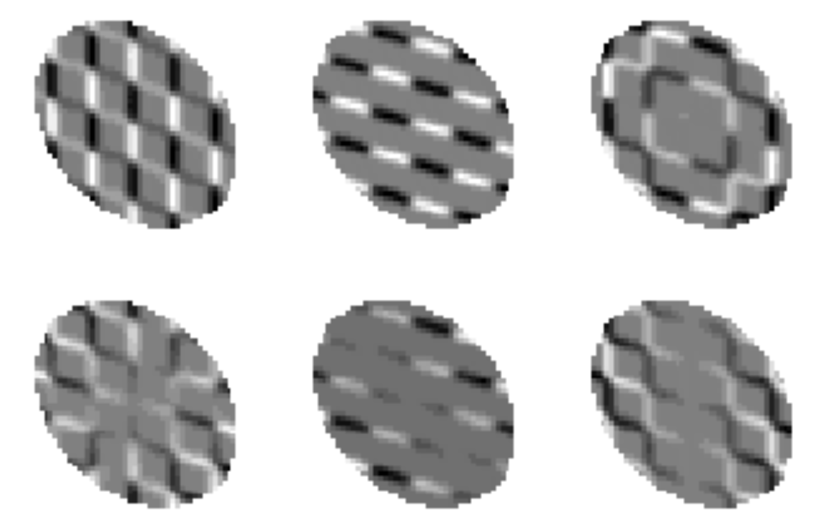
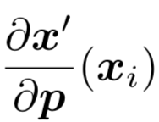
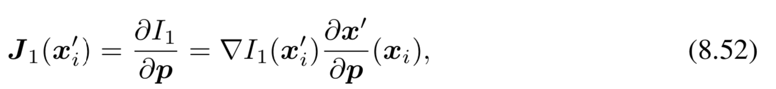
Computing Jacobian Images
template
Dellaert & Collins, 1999, Fast Image-Based Tracking by Selective Pixel Integration

Slide 16
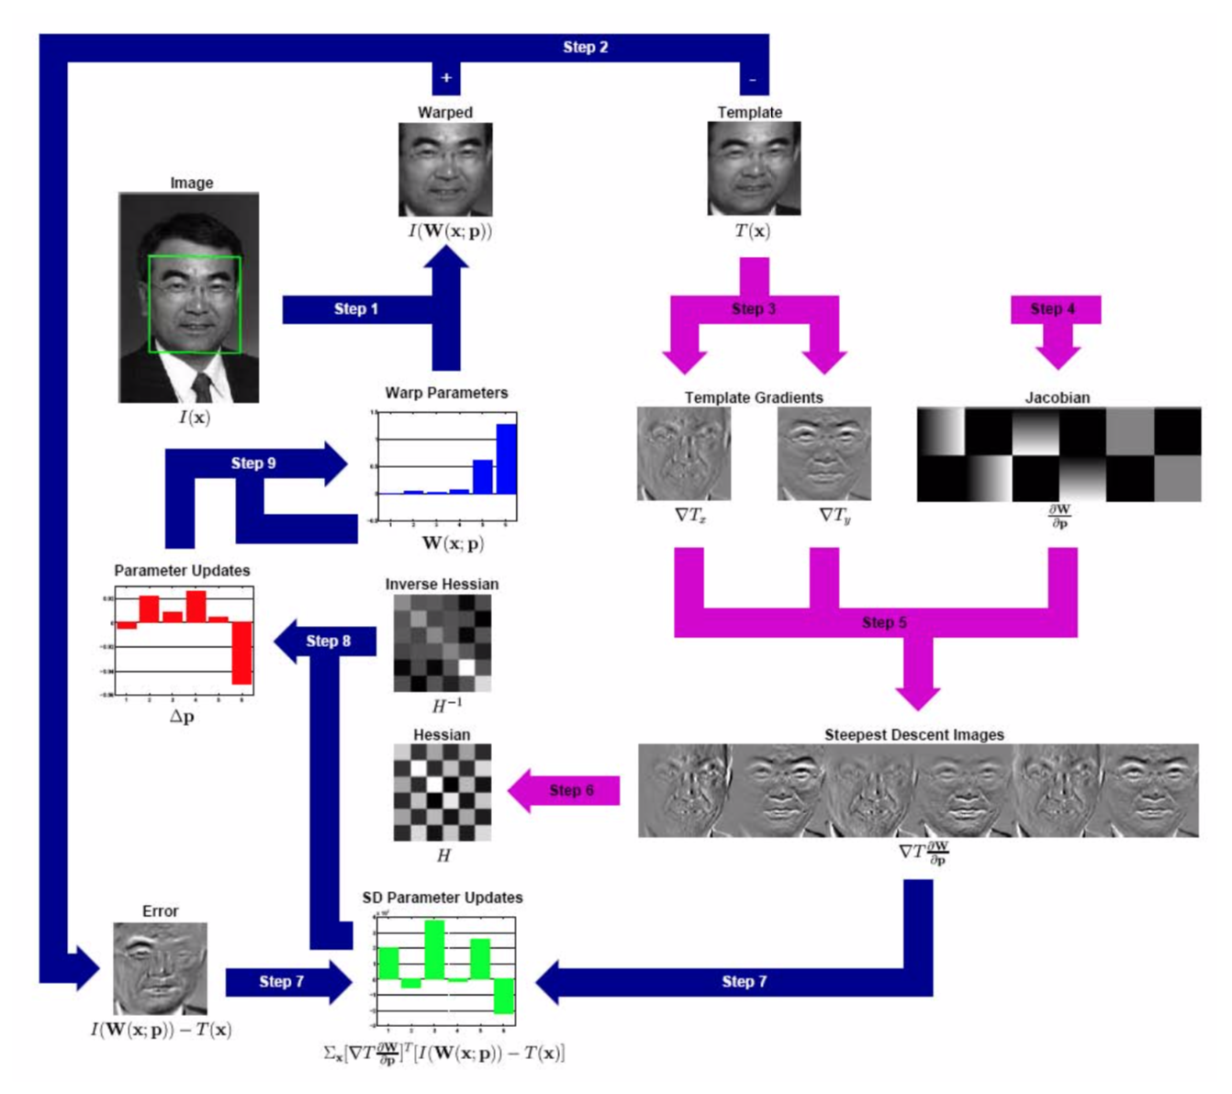
Inverse Compositional Approach

Slide 17
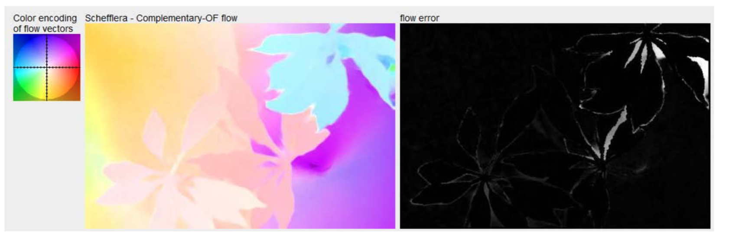
Optical Flow
Fully non-parametric model of motion
N pixels -> N flow vectors -> 2N parameters
Need some smoothness assumptions!
Hard to deal with occlusion

Slide 18
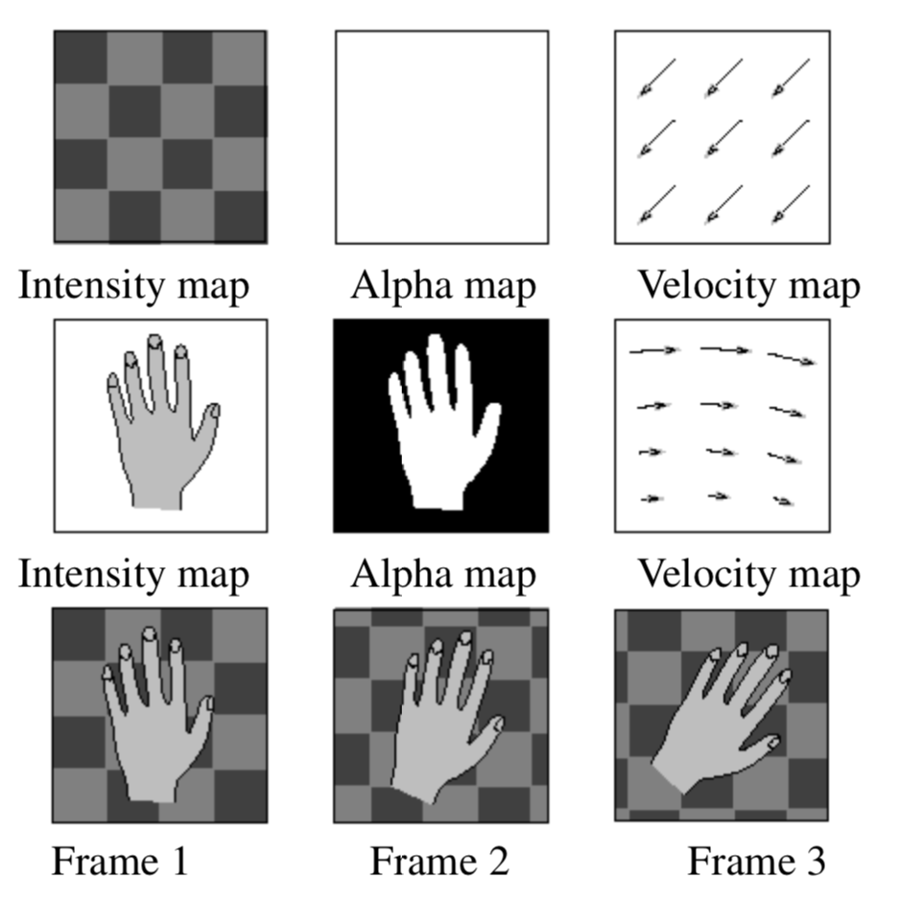
Layered Motion
One type of assumption to “regularize” optical flow
Estimate FG and BG layers

Slide 19
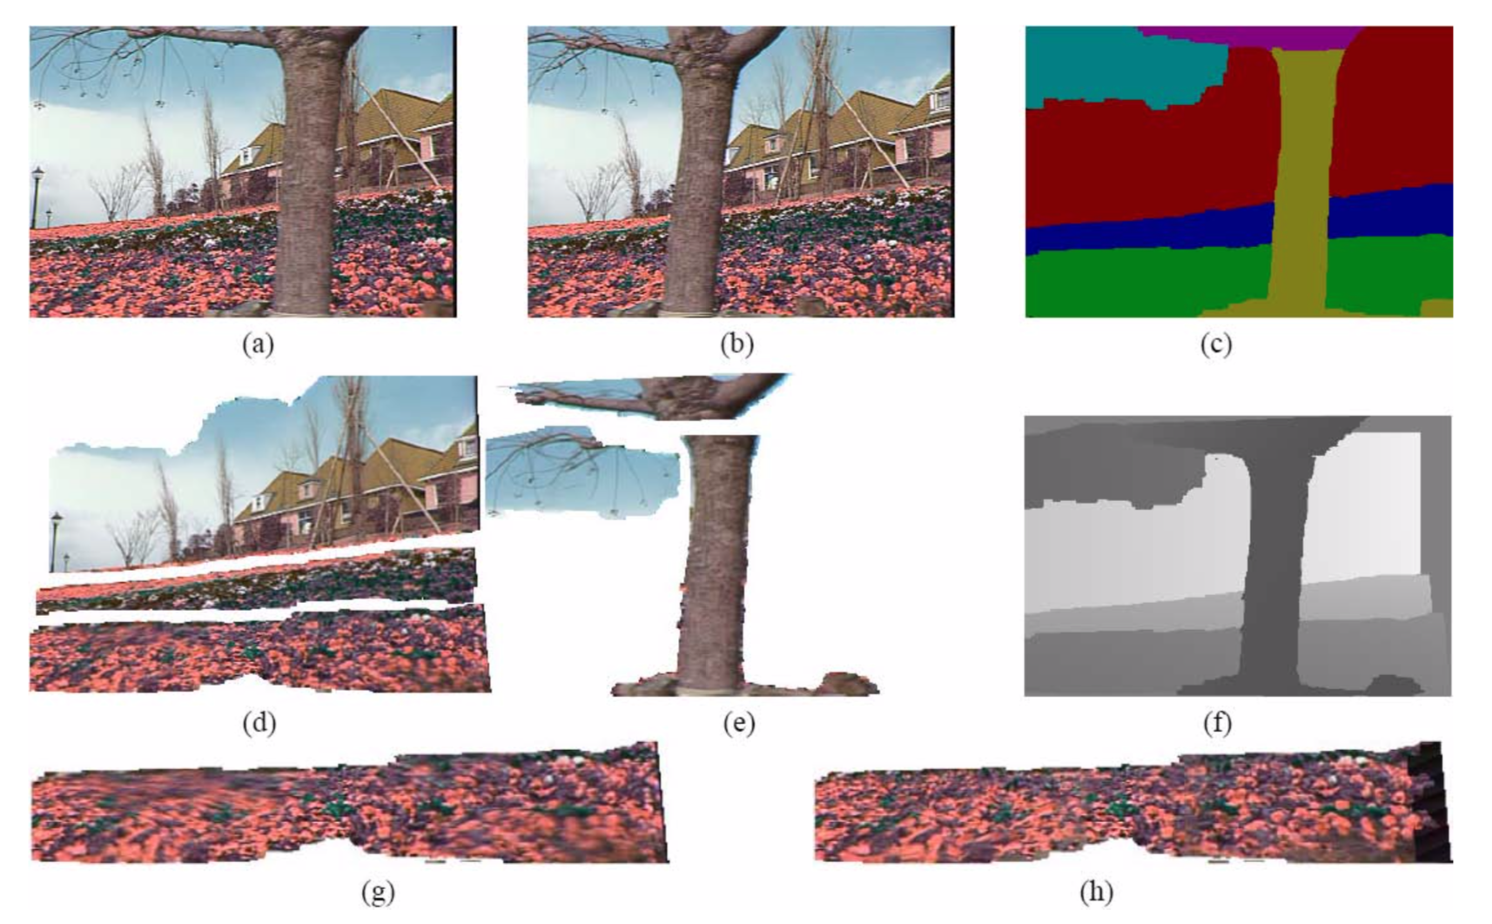
Layered Motion Results

Slide 20
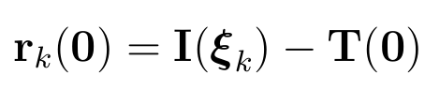
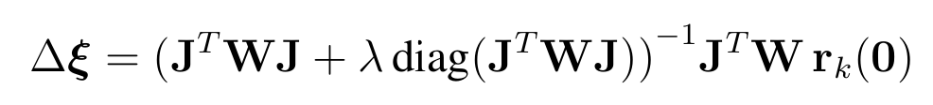
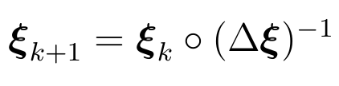
The Inverse Compositional Algorithm
[S. Baker and I. Matthews, 04]
We propose to take a deeper look at the Inverse Compositional algorithm from a learning perspective.
Notes:
Need to explain the regularizer

Slide 21
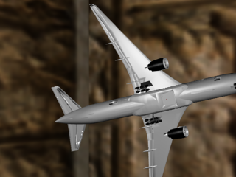
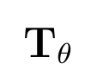
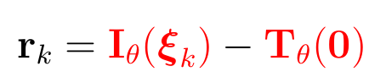
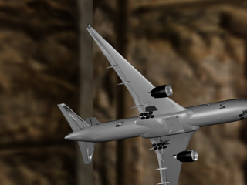
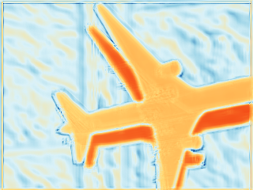
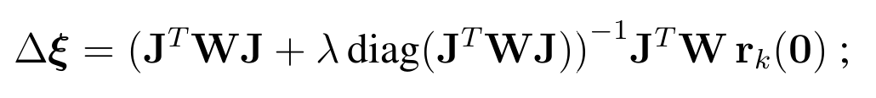
Take a Deeper Look at the Inverse Compositional algorithm
Contribution (A): Two-view Feature Encoder
(A) Two-View Feature Encoder

Slide 22
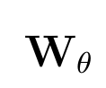
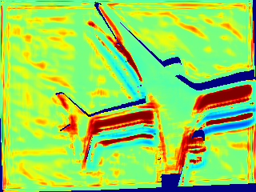
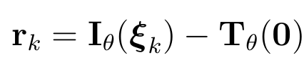
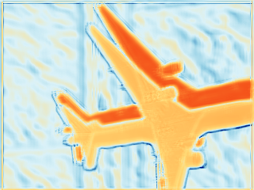
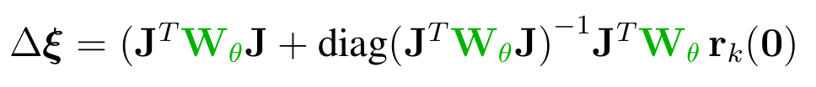
Take a Deeper Look at the Inverse Compositional algorithm
Contribution (B): Convolutional M-estimator
(B) Convolutional M-estimator

Slide 23
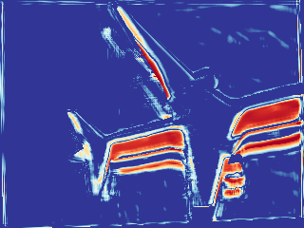
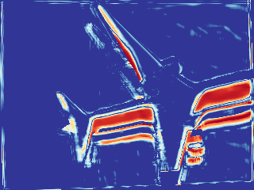




Take a Deeper Look at the Inverse Compositional algorithm
Contribution (C): Trust Region Network
(C) Trust Region Network

Slide 24















Coarse-to-Fine Inverse Compositional Algorithm
Feature Pyramid
(A) Two-View Feature Encoder
(A) Two-View Feature Encoder
(A) Two-View Feature Encoder
(A) Two-View Feature Encoder
$$∑$$
$$∑$$
$$∑$$
$$∑$$
$K$Inverse- Composition
$K$Inverse- Composition
$K$Inverse- Composition
$K$Inverse- Composition
Notes:
Emphasize all the components are end-to-end learned

Slide 25
Conclusion
We have taken a deeper look at the inverse compositional algorithm by reformulating it with
Two-view Feature Encoder
(B) Convolutional M-estimator
(C) Trust Region Network
The proposed solution is learnable, accurate, small, and fast in inference.

Slide 26










Visualization of Iterative 3D Rigid Motion Alignment
$$T$$
$$I$$
$$I(ξ^{GT})$$
Ours (A)+(B)+(C)
DeepLK
[Wang et al. ICRA, 2018]
Ours (A)
Ours (A)+(B)

